Slide 1
Anemometer Project
Muntaha Pasha
Update: 03/11/2021

Slide 2
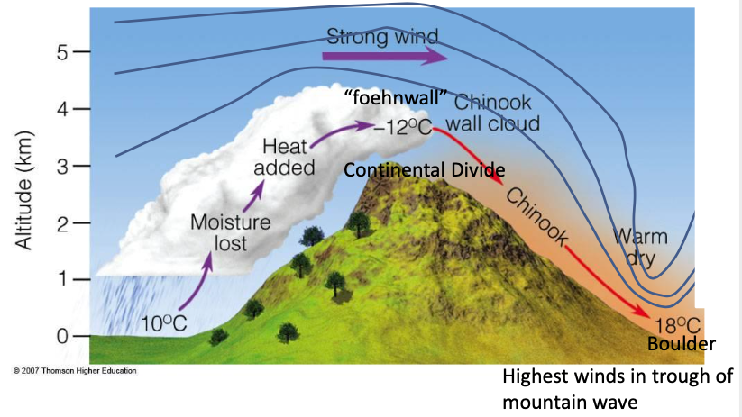
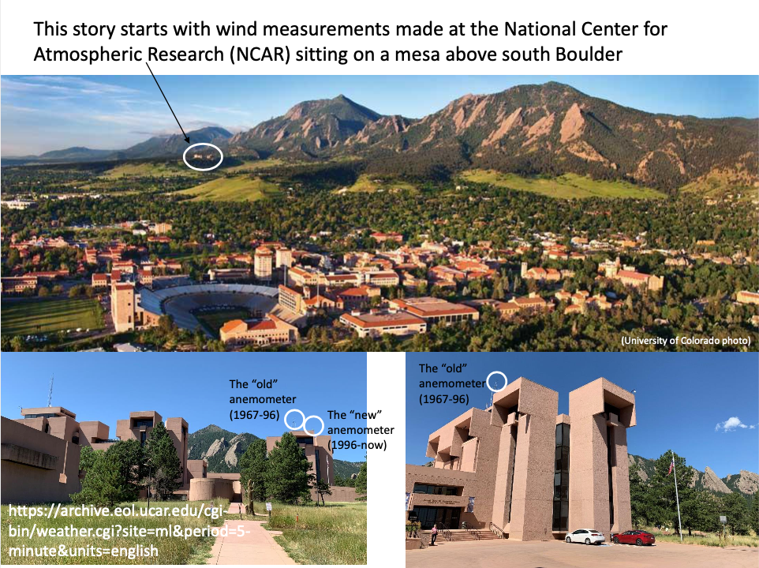
RESEARCH TOPIC Have we experienced a change in severe *Chinook Wind Events in Boulder?
A warm dry wind which blows down the east side of the Rocky Mountains at the end of winter.

Slide 3
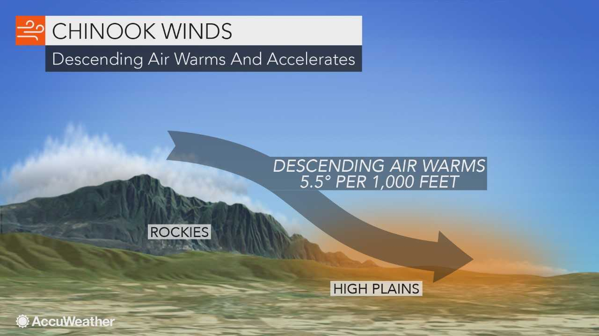
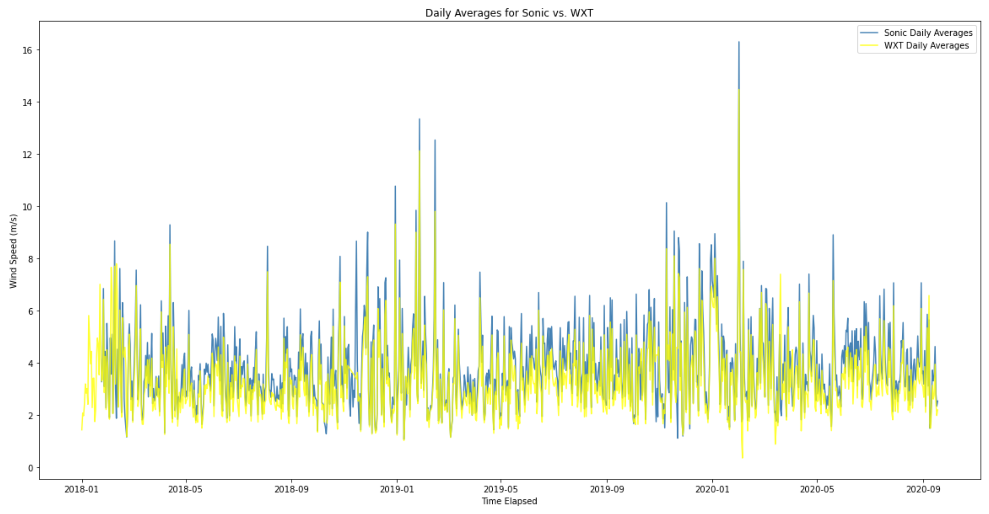
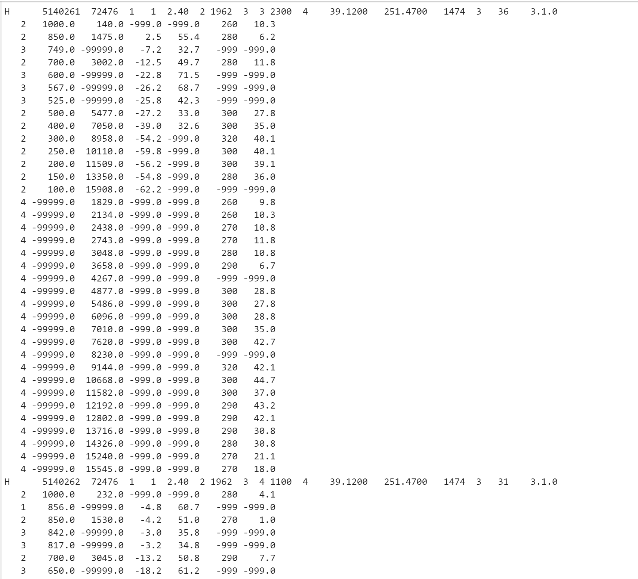
Recap
Studying Chinook Wind Events in Boulder, CO and trying to understand why wind speeds in these events have weakened over the years. Is this perhaps due to some changes in climate, or is this due to newer/updated wind instruments?
Anemometer Graphing has been completed, so let’s look at Radiosonde Data now across different stations in Colorado and see if any specific weather conditions in the past have alluded to a chance or probability of a severe wind event.
First thing to do is to ingest Radiosonde data into a Pandas Data frame. However, how can I format this data so it can be used as efficiently as possible? How do I take the header information and make it an identifier of my data as opposed to a line I just “skip” over?

Slide 4
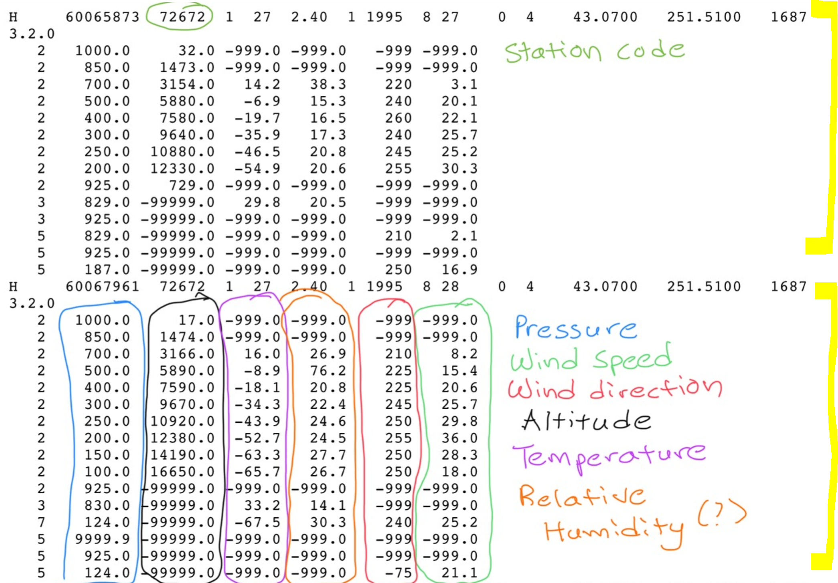
Radiosonde Data (Sample)
This is what a sample of my data looks like. We have a file with a station code (In this case, 72672, which identifies some station (I believe this is Grand Junction), and the row that it’s a part of is a Header row which gives you different metadata. Tells you things like the date at which the sounding was taken, latitude, longitude, etc.
The columns correspond to different measurements taken as the radiosonde data is sent up into the atmosphere. Different variables are labeled.
(This repeats many times).

Slide 5
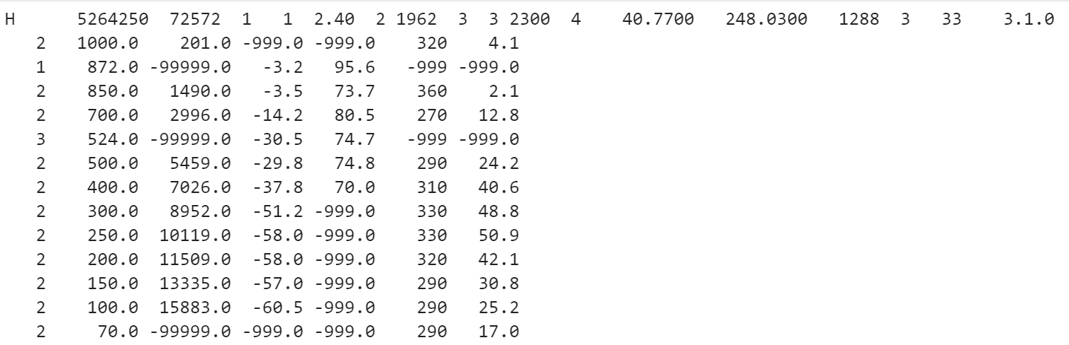
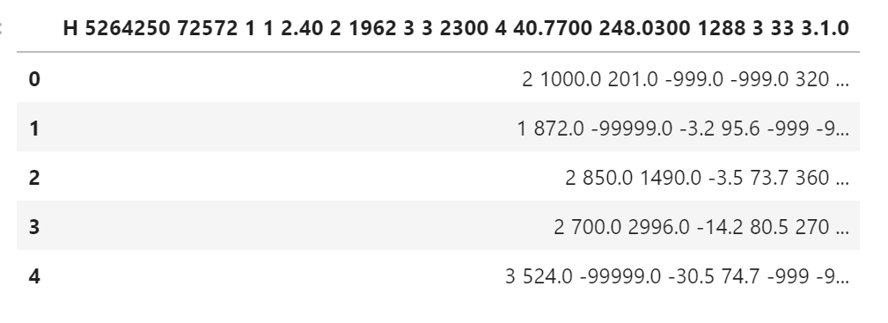
So, what’s the issue?
Ingesting the data into a data frame is easy. But how do I format it? How can I make my data neatly organized by…
Either Station Code…
Or, Ideally, Datetime.
Parsing may be an issue as well.
Here’s my sample data (just showing one header)
Again, these files usually have multiple headers.
Here’s how it looks in the data frame.

Slide 6
Ideally how I want the data frame to look
StationID | DateTime | Pressure | Wind Spd | Wind Dir | Altitude | Temp (C) | R.H
77756 | 1965-8-8 | 1000 | # | # | # | # | #
# | # | # | # | # | # | # | #
# | # | # | # | # | # | # | #
… | 1965-8-8 | 100 | # | # | # | # | #
77756 | 1966-8-9 | 1000 | # | # | # | # | #
0
1
2
3
4
5
In order to get a table like this, I need to repeat several information pieces of the header in the table. So I’ll need station code 77756 (for example) repeated 10 times for pressure levels 1000 to 100. Then the next 10 rows contain the same station’s data for the next date time (which will also need to be manually parsed out of the header).
This is where I need your help!!

